Slide 1




Loop statements in
Python

Slide 2


Contents:
Loops in python
While Loop, using else with While loop
For Loop in python
Range() function

Slide 3

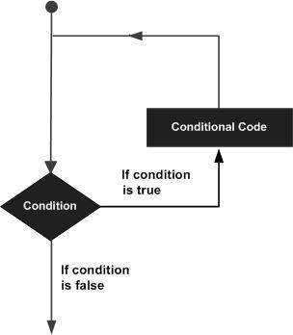
Loops in Python
In python, if we want to execute group of statements multiple times then we are going to use Iterative statements.
A rule which applies repeatedly on any condition or statement is called Iterative statements.
The looping simplifies the complex problems into the easy ones.
It enables us to alter the flow of the program so that instead of writing the same code again and again, we can repeat the same code for finite number of times

Slide 4

While Loop:
In python, a while loop is used to execute a block of statements repeatedly until a given condition is satisfied. And when the condition becomes false, the line immediately after the loop in the program is executed.
Syntax:-
while expression: statement(s)
Examples:-
# while loop
count = 0
while (count < 3):
count = count + 1
print("Hello world")

Slide 5



Using else with while Loop:
As discussed above, while loop executes the block until a condition is satisfied. When the condition becomes false, the statement immediately after the loop is executed.
The else clause is only executed when your while condition becomes false. If you break out of the loop, or if an exception is raised, it won’t be executed.
Syntax:-
while condition: # execute these statements else: # execute these statements
Example:-
# combining else with while
count = 0
while (count < 3):
count = count + 1
print("Hello world")
else:
print("In Else Block")

Slide 6

For Loop in Python
The For loop statement in Python supports repeated execution of a statement or block of statements that is controlled by an iterable expression.
A For loop lets you execute a block of similar code operations, over and over again , until a condition is met.
A for loop can Iterate over every item in a list or go through every single character in a string and won't stop until it has gone through every single character. It reduce repetitiveness in your code.

Slide 7
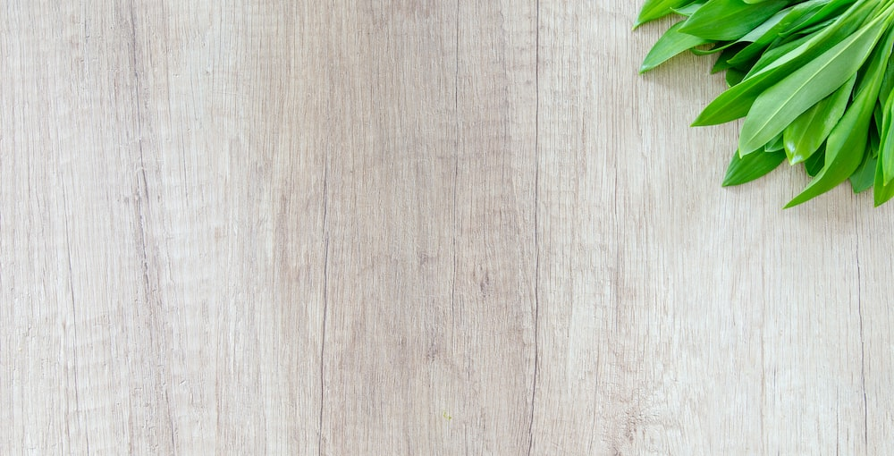
For loop in python
Syntax:-
for value in sequence:
{ code block }
Example:-
#example for iterating a string using for loop
fruit="apple"
for i in fruit:
Print(i)

Slide 8


Range() Function:
The range() function is used to generate the sequence of the numbers. If we pass the range(10), it will generate the numbers from 0 to 9.
Syntax:-
Range(start, stop, step size)
Example:-
#for printing the range of numbers from 0-9
print(range(10))
#printing 10th multiple table
n=int(10)
for i in range(1,11):
c=n*i
print(n,"x",i,"=",c)

Slide 9

Thank You

